Slide 1
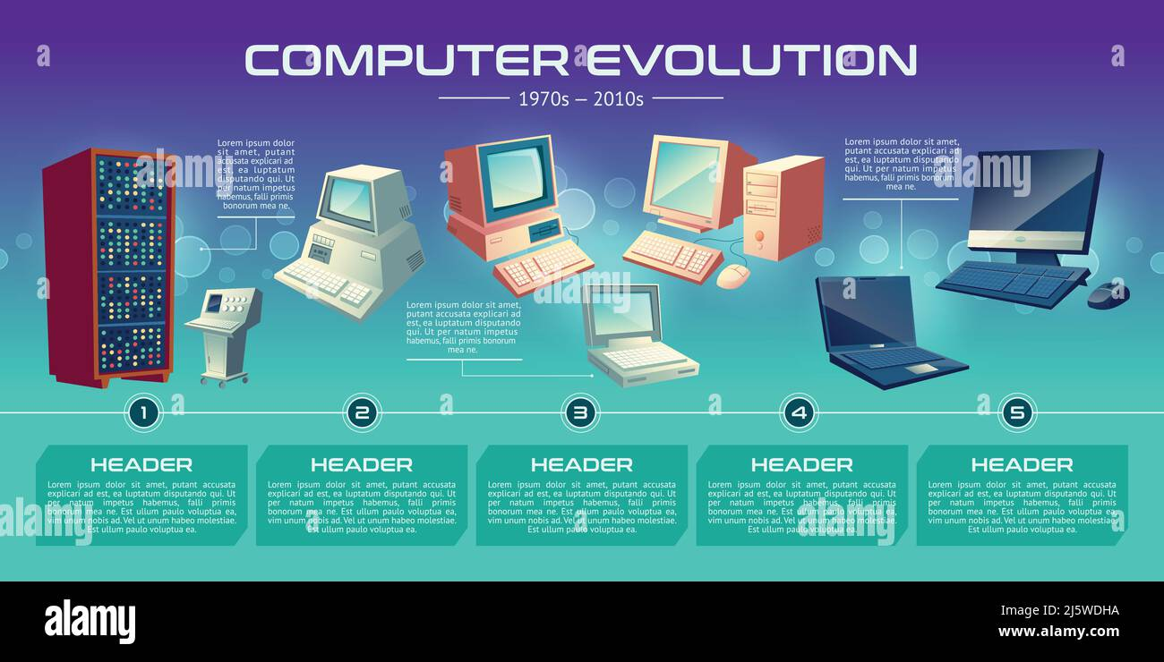
Evolution Of computer
&
Modern Computer

Slide 2
Evolution Of computer
The history of computers dates back to the 19th century, when the first mechanical computers were developed. However, the modern digital computer that we know today has gone through several stages of evolution, known as generations. Here's a brief overview of each generation of computers:
First Generation Computer (1940-1956)
Second Generation Computer (1956-1963)
Third Generation Computer(1964-1971)
Fourth Generation Computer(1971-Present)
Fifth Generation Computer(Present and Beyond)

Slide 3
First Generation (1940-1956)
The first computers were large and bulky machines that used vacuum tubes for processing. They were primarily used for scientific and military purposes, and were very expensive to build and maintain.
Second Generation (1956-1963)
The second generation of computers used transistors instead of vacuum tubes, which made them smaller, faster, and more reliable. They also used magnetic core memory, which was faster and more efficient than previous forms of memory.

Slide 4
Third Generation (1964-1971)
The third generation of computers used integrated circuits (ICs) which made them even smaller, faster, and more powerful. They also introduced operating systems, high-level programming languages, and time-sharing systems.
Fourth Generation (1971-1989)
The fourth generation of computers used microprocessors, which made them even smaller, more powerful, and more affordable. They also introduced personal computers, graphical user interfaces (GUIs), and networking technologies.

Slide 5
Fifth Generation (1989-Present)
The fifth generation of computers is characterized by the use of artificial intelligence (AI) and advanced technologies like natural language processing, robotics, and expert systems. They are also increasingly focused on networking and communication, as well as the development of new computing paradigms like quantum computing.
Overall, the evolution of computers has been driven by a combination of technological advancements, economic factors, and changing societal needs. Each generation has brought new capabilities and applications, as well as new challenges and opportunities for innovation.

Slide 6
Emerging Technology Trends
There are several emerging technology trends that are shaping the future of various industries and changing the way we live and work. Here are a few examples:
Artificial Intelligence (AI)
AI is becoming more advanced and is being applied in various industries such as healthcare, finance, manufacturing, and more. With the help of machine learning and deep learning, AI is being used to automate tasks, improve decision-making, and provide personalized experiences.

Slide 7
Internet of Things (IoT)
IoT refers to the interconnectedness of devices, sensors, and systems. It is being used in industries such as agriculture, healthcare, transportation, and more to improve efficiency, reduce costs, and provide better insights.
5G Technology
5G technology promises to offer faster internet speeds and better connectivity, which can enhance various industries such as gaming, healthcare, and transportation.

Slide 8
Blockchain
Blockchain is a decentralized ledger technology that is being used in industries such as finance and supply chain to provide greater security and transparency in transactions.
Virtual Reality (VR)
VR technologies are being used in industries such as gaming, education, and healthcare to provide immersive experiences and enhance learning and training.

Slide 9
Quantum Computing
Quantum computing is a technology that uses quantum mechanics to process information. It has the potential to revolutionize industries such as finance, cybersecurity, and pharmaceuticals.
Overall, these emerging technologies are expected to have a significant impact on the way we live and work in the future, and organizations that are able to effectively adopt and leverage them will have a competitive advantage.

